Slide 1




FMODetect: Robust Detection of Fast Moving Objects
Denys Rozumnyi^{1,4}, Jiří Matas⁴, Filip Šroubek², Marc Pollefeys^{1,3}, Martin R. Oswald¹
¹Department of Computer Science, ETH Zurich ³Microsoft Mixed Reality and AI Zurich Lab ²UTIA, Czech Academy of Sciences ⁴Visual Recognition Group, CTU in Prague
International Conference on Computer Vision 2021

Slide 2
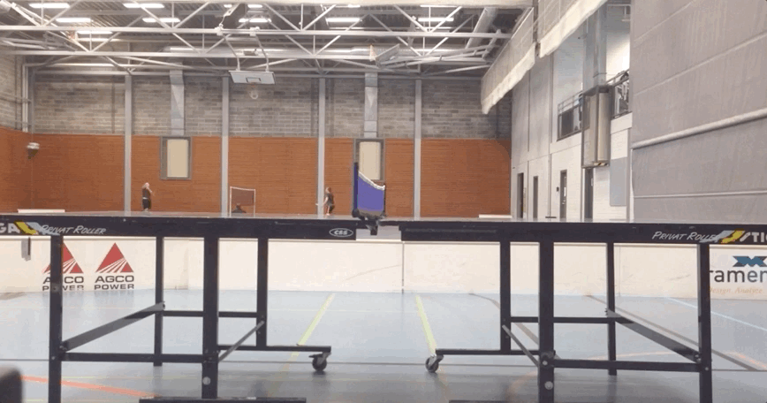
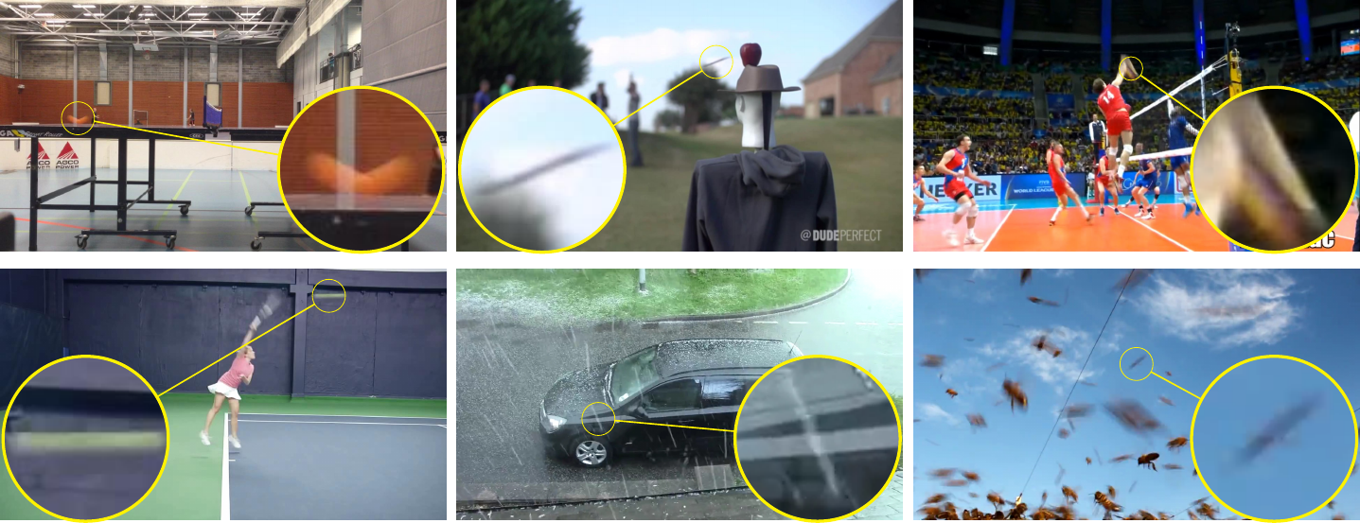
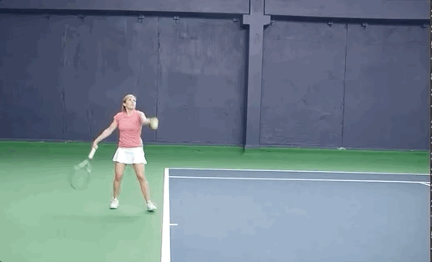
Preliminaries
Definition: object is called fast moving (FMO) if it travels a distance larger than its size in one frame.
Applications: sports analysis, astronomy, anomaly detection.
Temporal super-resolution: replacing expensive high-speed cameras with software.
Rozumnyi et al. @ CVPR 2017

Slide 3
Datasets
The problem of detecting and tracking FMOs has been unnoticed by the research community.
Such objects are not present in standard tracking datasets (Got10k, LaSOT).
Only recently proposed datasets, such as TbD, contain such motions.

Slide 4
Problem setting
Inputs:
image I with potentially several objects that are moving fast and thus appearing blurred,
background B without the object.
Approach:
step one: detect all FMOs,
step two: remove the background, fit the trajectory,
step three: deblur appearance.

Slide 5
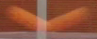
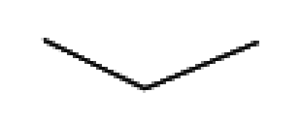



Classical problem formulation
Local assumption: a single object with 2D appearance F and 2D shape M moving over static background B.
H is the blur caused by motion along object trajectory.
Image formation in 2D is modelled as follows:
Background
Blurred object
Foreground
Visibility map
Modified from Rozumnyi et al. @ CVPR 2017

Slide 6
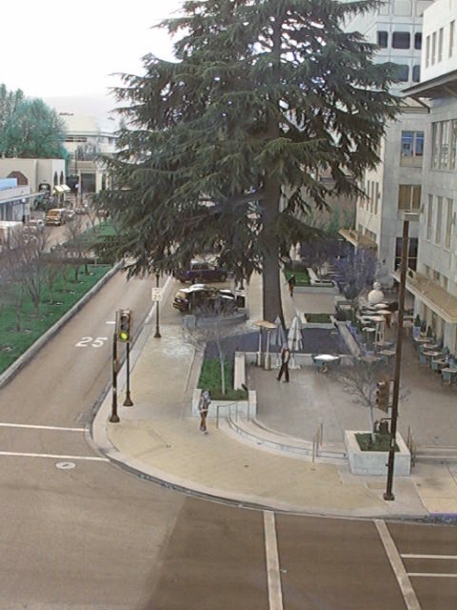

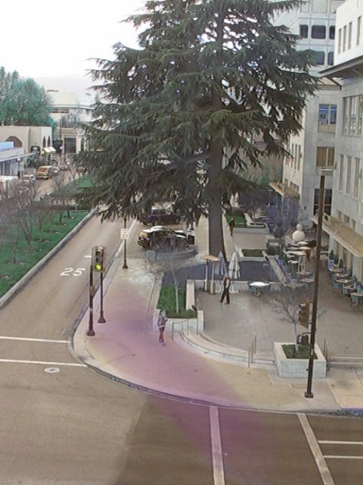

Dataset generation
Synthetic dataset for training is easy to generate.
We sample:
backgrounds from standard tracking datasets,
random trajectories,
objects with random size and texture.
Model
,
,
=

Slide 7
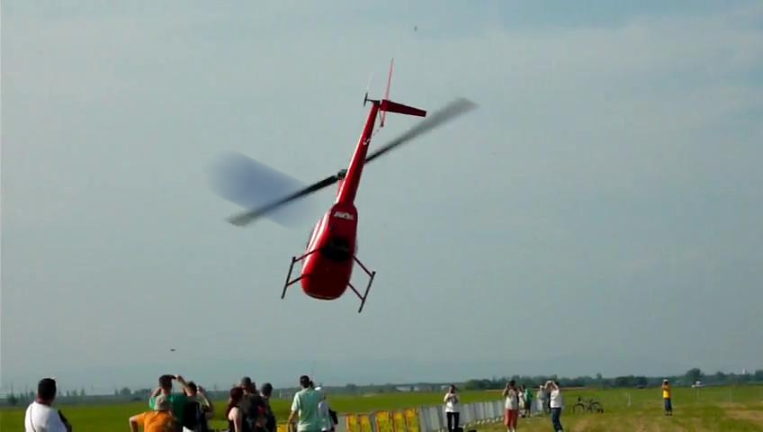
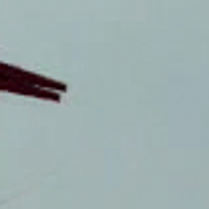
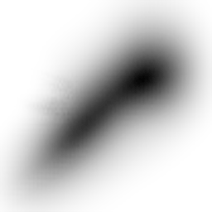
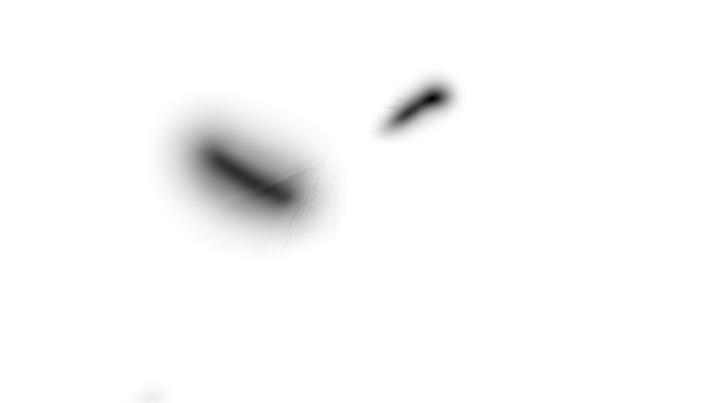
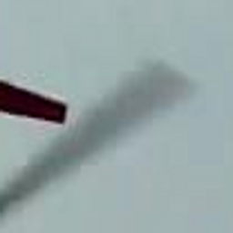
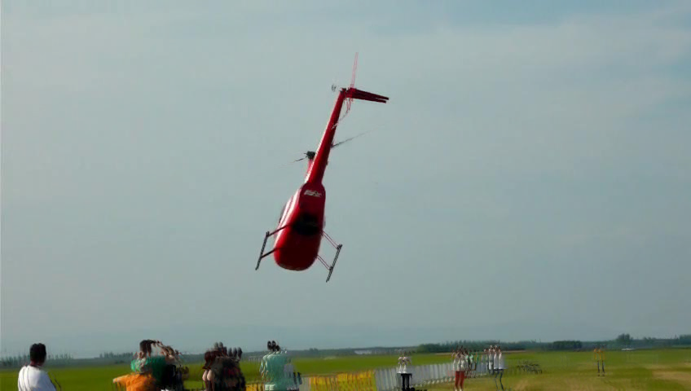
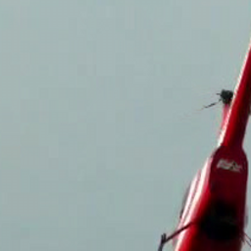
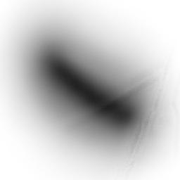
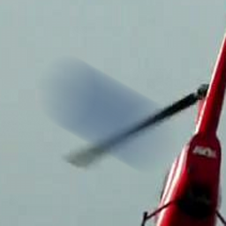
Step one: Detection network
The FMO detection network recovers all fast moving objects (FMOs) in the input image.
Truncated distance function (TDF) is an intermediate output of our method for a detected trajectory.
Detection Network
Component
analysis
FMO 1
Matting & fitting network
Image
.
.
.
.
.
.
.
.
256
256
128
FMO N
128
64
TDF
64
32
Matting & fitting network
Background
16
16

Slide 8
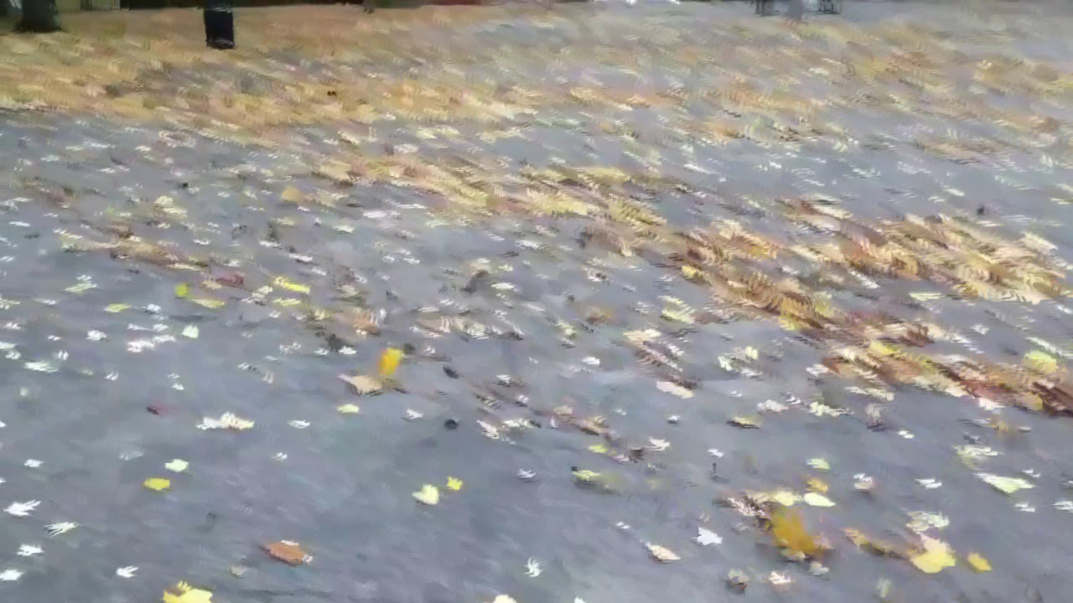
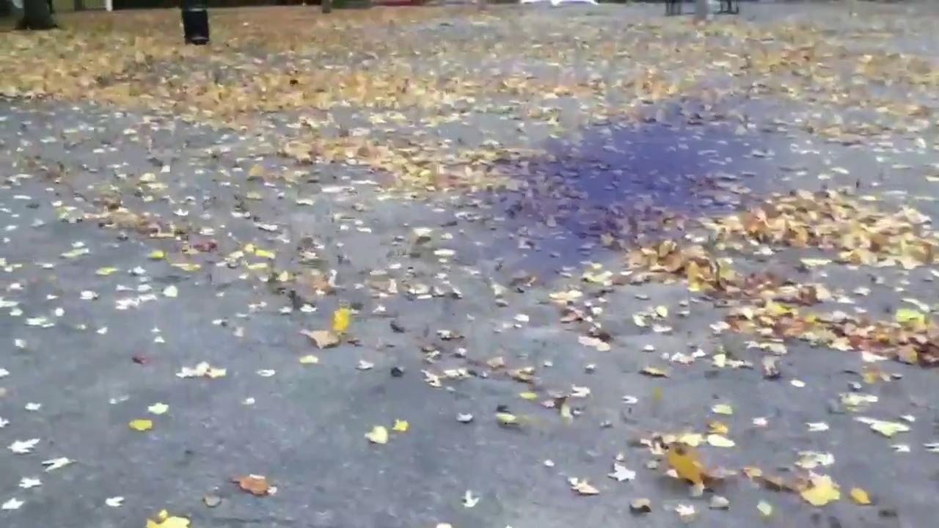
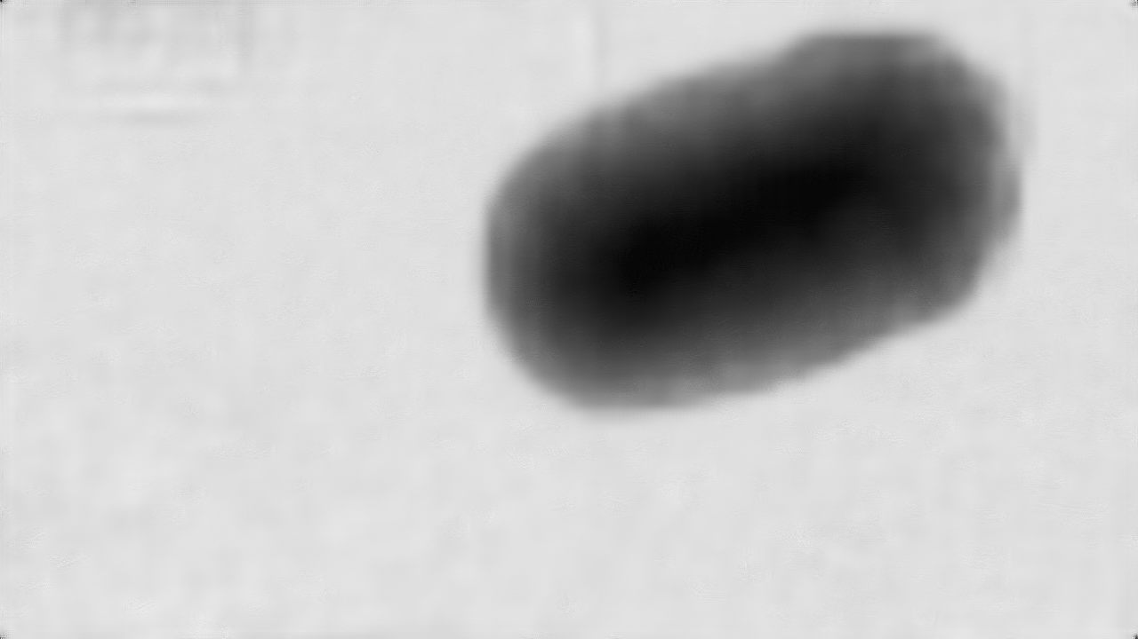
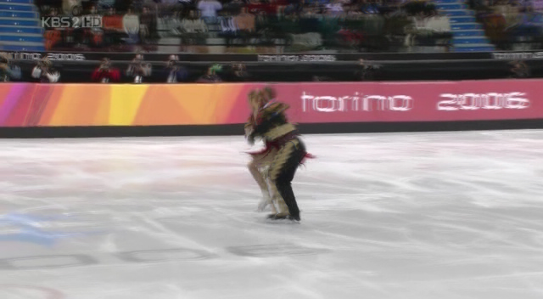
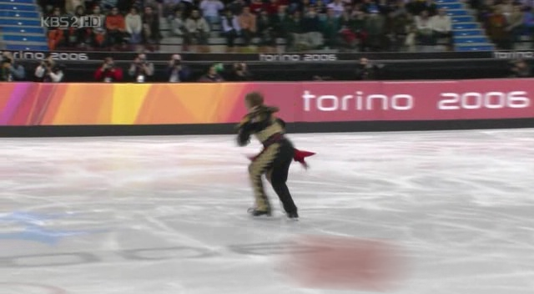
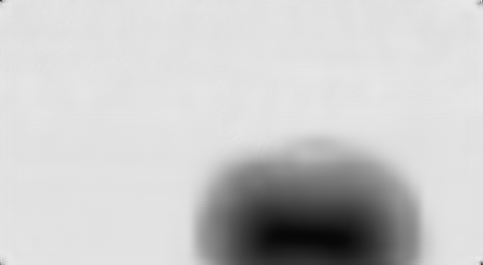
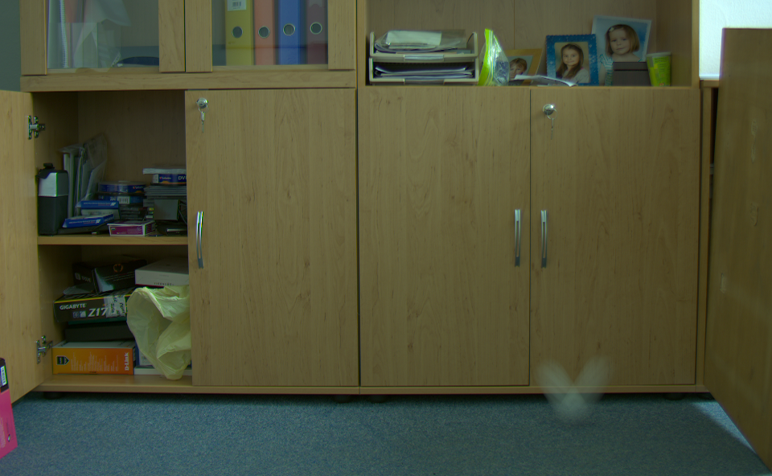
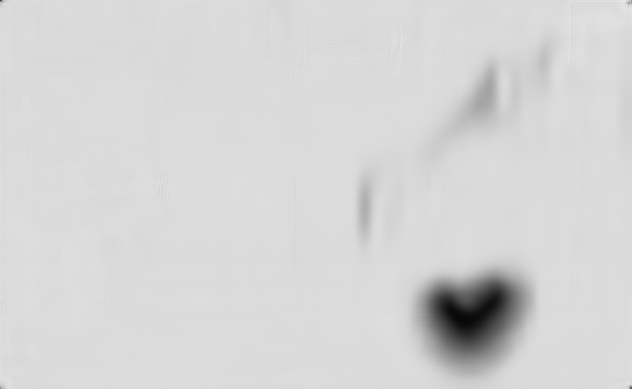

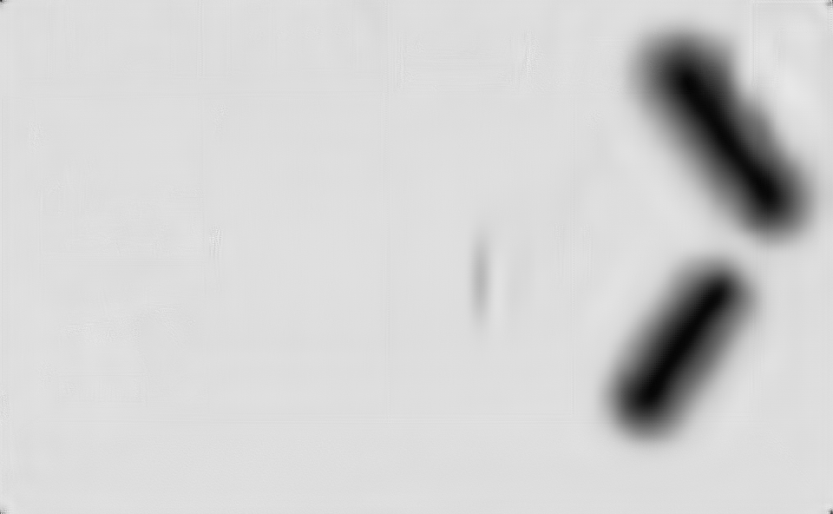
Step one: Detection network
Trained only on synthetic dataset with a single spherical object.
Works well on real-world data with complex trajectories and objects.
Synthetic
Real
Real

Slide 9
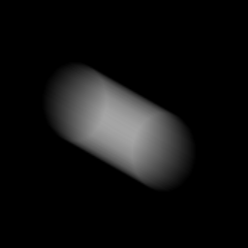




Step two: Matting and fitting network
Architecture: one encoder, three decoder (trajectory, matting, and probability of being FMO).
For each object classified as FMO, we propose an optimization-based deblurring by ADMM (step three).
Matting & fitting network
Matting decoder
a)
Deblurring
Matting
Detection Network
If FMO
b)
256
256
128
c)
128
64
FC
FMO? (Yes/No)
Decision decoder
64
32
16
16
Fitting decoder
Parametric Curve

Slide 10
Step two: Matting and fitting network

Slide 11
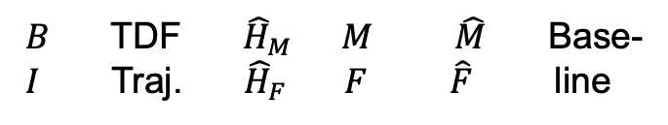
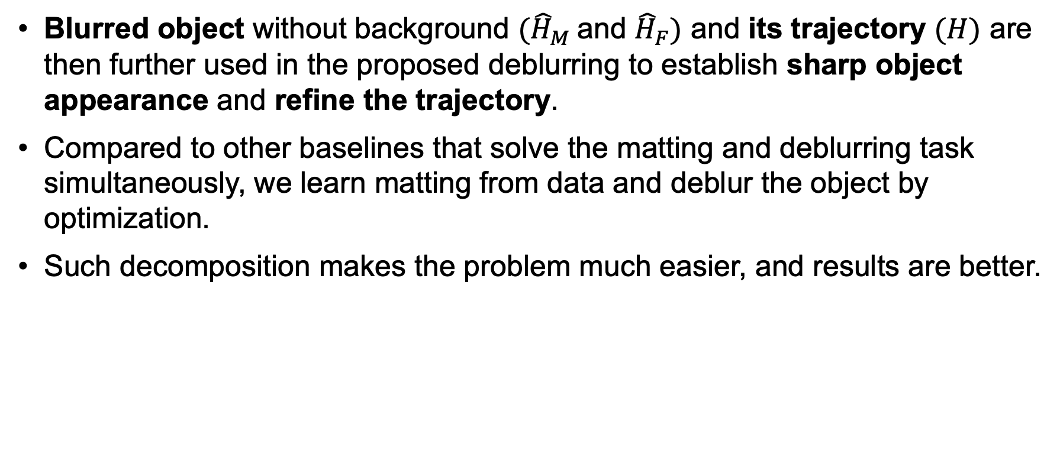
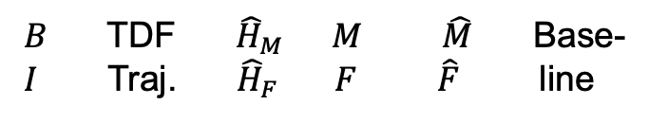
Step three: Deblurring
Blurred object without background $({\hat{H}}_{M}$and ${\hat{H}}_{F})$ and its trajectory $(H)$ are then further used in the proposed deblurring to establish sharp object appearance and refine the trajectory.
Compared to other baselines that solve the matting and deblurring task simultaneously, we learn matting from data and deblur the object by optimization.
Such decomposition makes the problem much easier, and results are better.
$B$ TDF ${\hat{H}}_{M}$ $M$ $\hat{M}$ Base-
$I$ Traj. ${\hat{H}}_{F}$ $F$ $\hat{F}$ line
$B$ TDF ${\hat{H}}_{M}$ $M$ $\hat{M}$ Base-
$I$ Traj. ${\hat{H}}_{F}$ $F$ $\hat{F}$ line

Slide 12
Evaluation on real-world data
FMODetect
outperforms the previous methods
is much faster (runs in real-time),

Slide 13
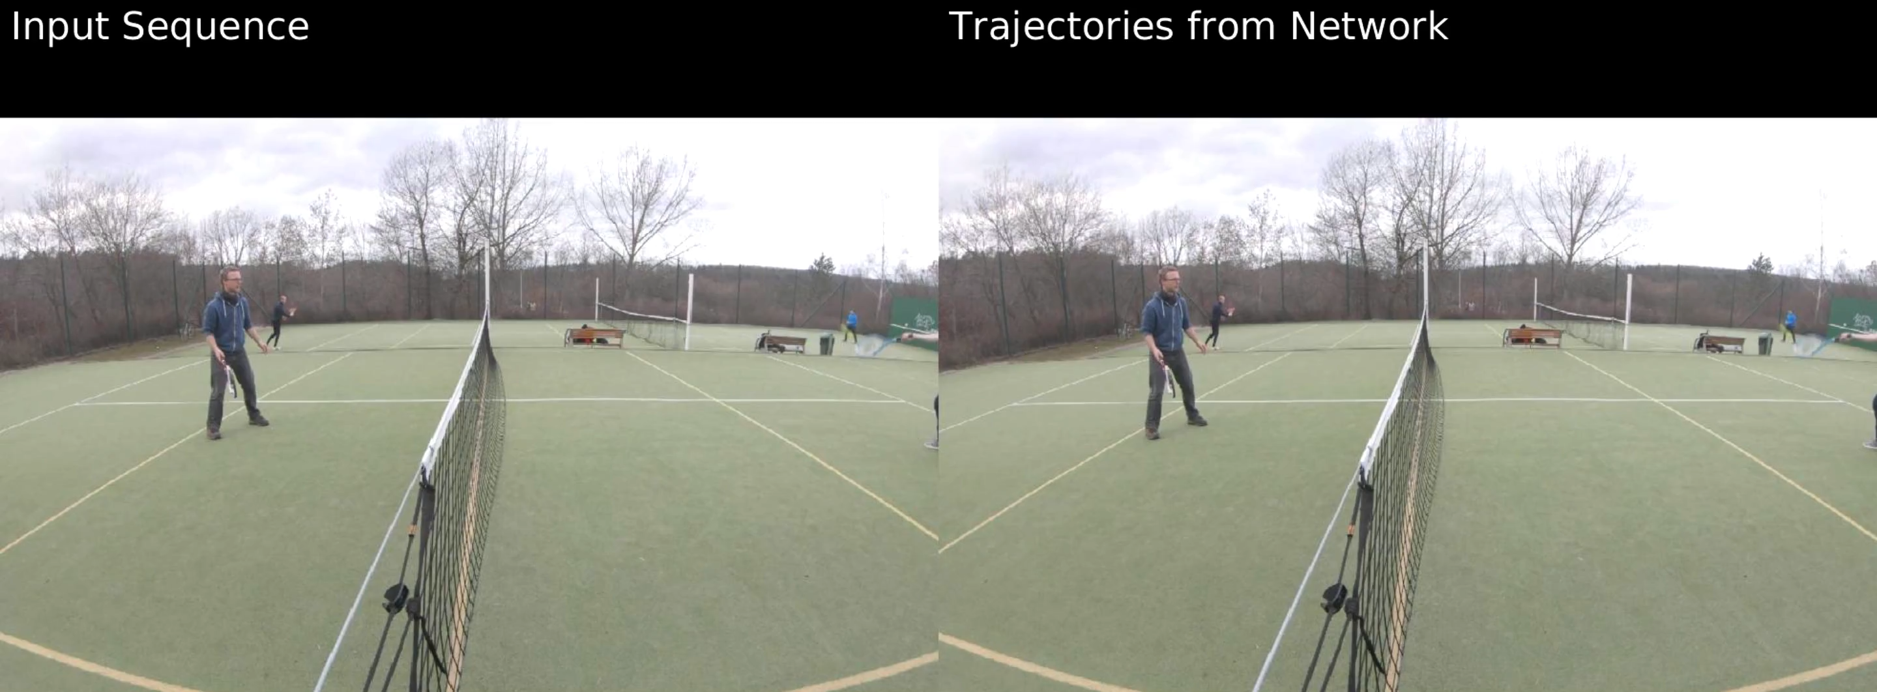
Evaluation on real-world data

Slide 14
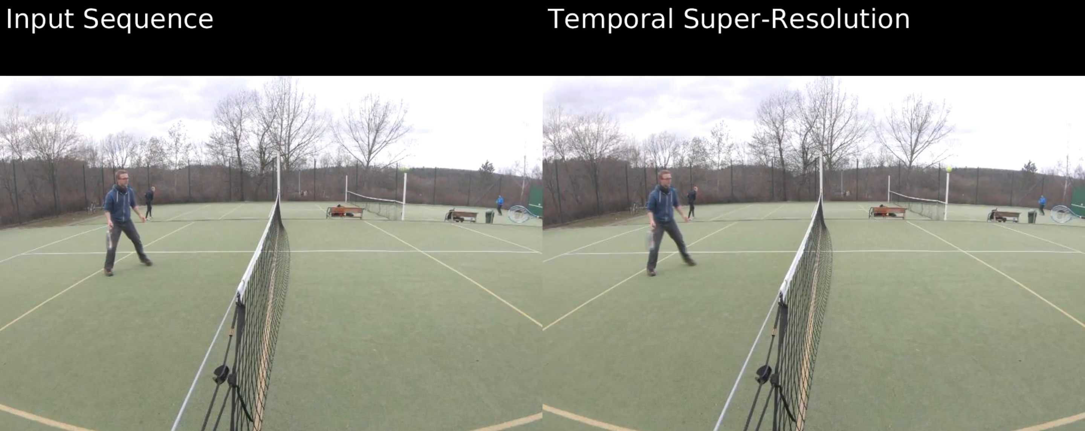
Temporal super-resolution

Slide 15
Deblurring on real-world data
In terms of deblurring quality, the reconstructed object is sharper compared to previous methods.

Slide 16
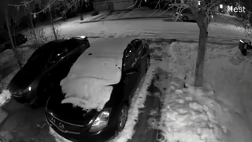
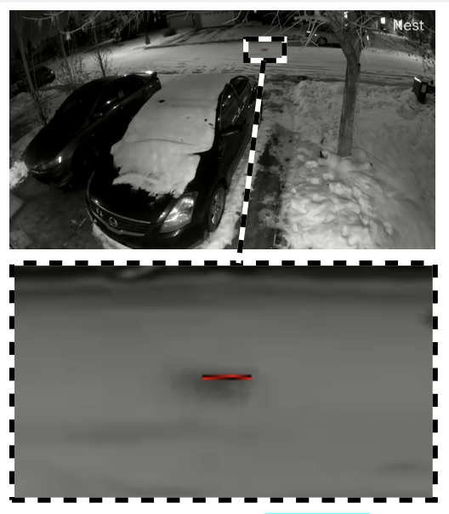
Real-time FMO retrieval: surveillance camera (rabbit)

Slide 17
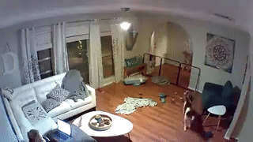
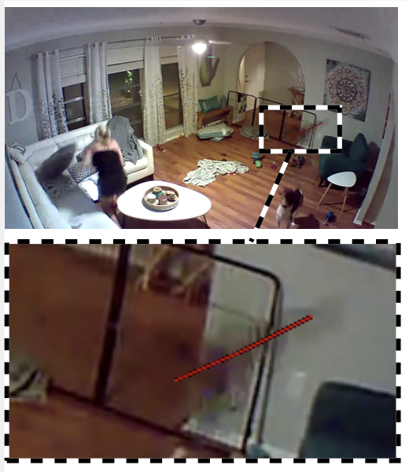
Real-time FMO retrieval: surveillance camera (bird)

Slide 18

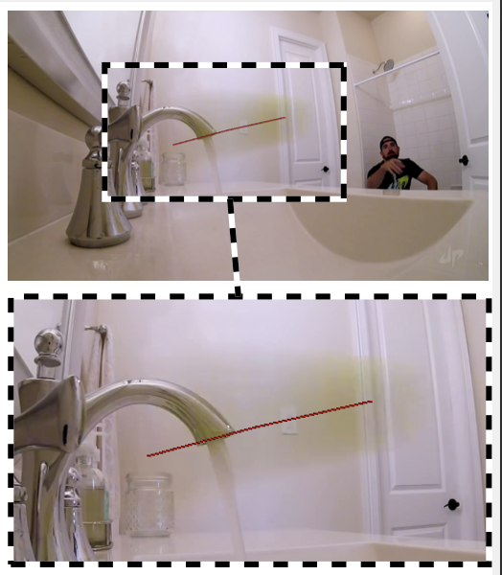
Real-time FMO retrieval: trick shots (tennis)

Slide 19

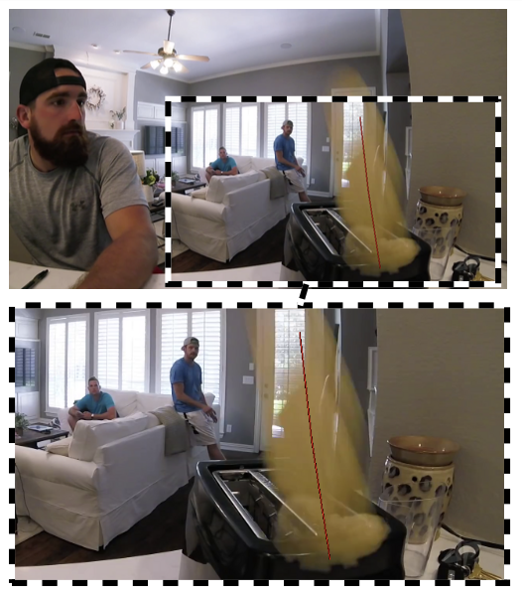
Real-time FMO retrieval: trick shots (toast)

Slide 20

Thank you!
We presented FMODetect:
the first learning-based approach for FMO detection
simpler than previous methods
does not require extensive parameter tuning
works with the same settings for a wide range of scenarios
Code is released on GitHub: https://github.com/rozumden/FMODetect

